Slide 1
Corporate Story Telling

Slide 2
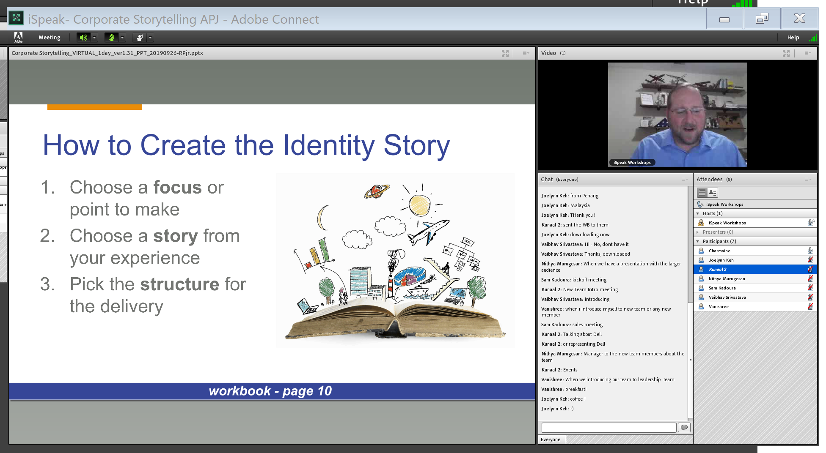

Slide 3
Identify
I began training out of necessity. I hated every day of training 1000’s of student. I trained everyday on weekends too (took Leave from 1-7th April in one year)
Being Anxious and lack of confidence
Its only when I switched my job to a company I realized that the Data Analytics skills I developed made me more efficient than 3-5 years experienced members – within 1 year itself I was promoted to lead the team
I learned that learning and teaching gave me far more clarity and hold of the subject – Further confirmed by Strength Finder that one of my Strengths is Learning and other one Development
Today I am an avid Learner with over 80 online courses and a Analytics Trainer (teaching over 100 hours to thousands of students)
Analytics Practitioner, Lifeaholic Evangelist, Learner, YouTube and Scuba Diver

Slide 4
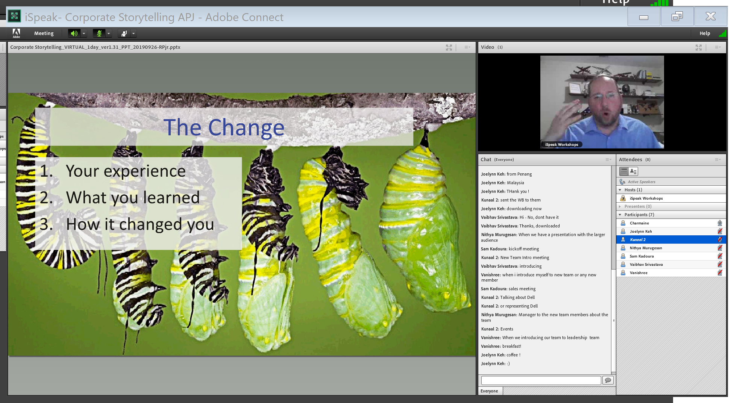

Slide 5
Finding my strength
I have always been driven by Insecurity and Anxiety if what will happen with my future – Always
While looking for a way out of this anxiety loop – I found a book named strength finder – I took the test
Found that Learning and Development is 2 of my key strengths – So decided to maximize on them
Today I have learned over 80 courses online – this being one of them
I have done over 100 hours of training in this year and I have been confident about myself

Slide 6
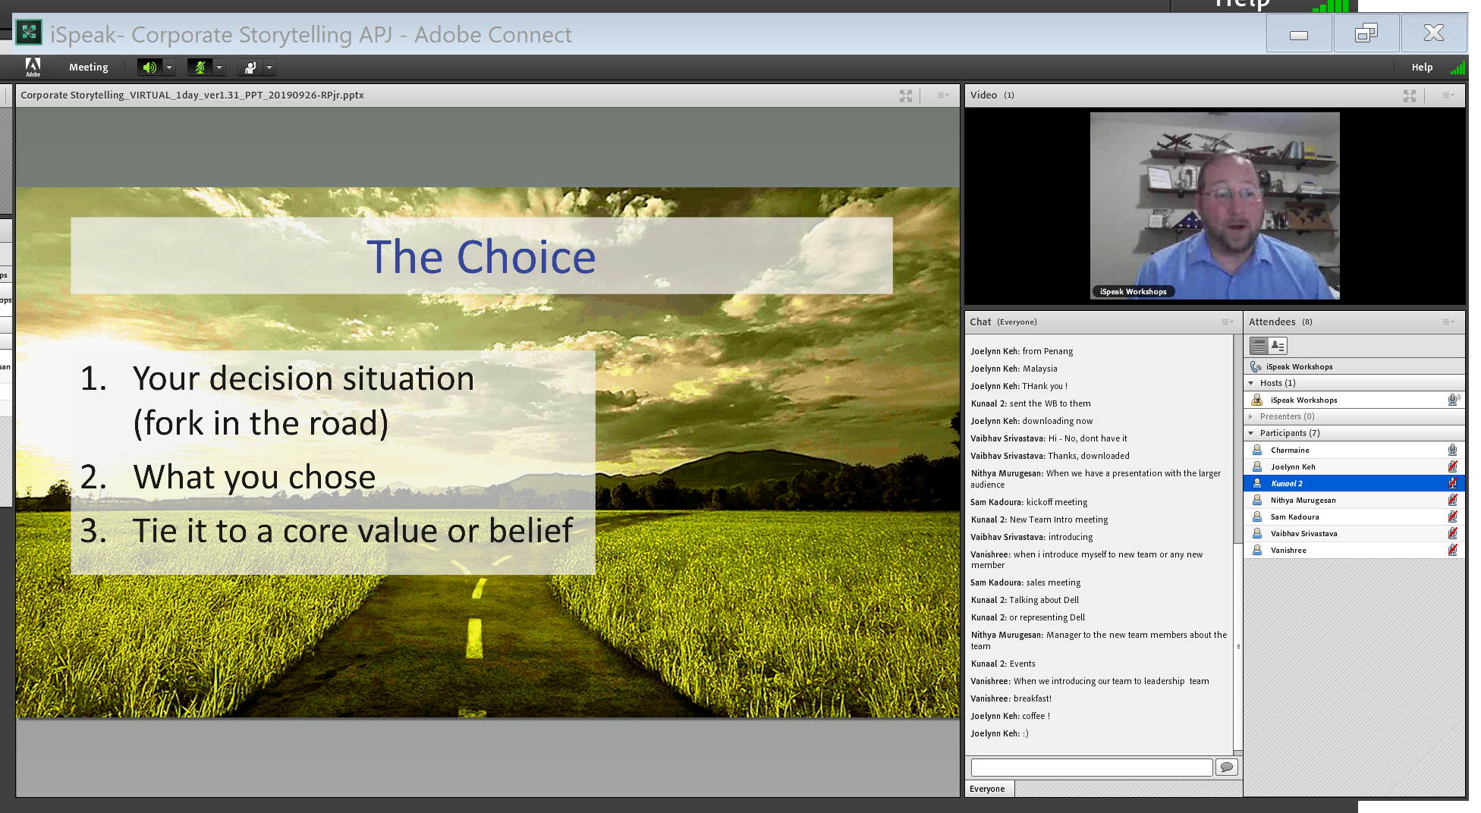

Slide 7
No MBA
Post 8 years I was faced with an decision of take do an MBA or not
I believe that we live in an era where information is abundant – we need to get better at assimilating them – Hopefully do our own MBA and its cheaper
While in a Honeymoon in a Island called Gili T, Bali – I met one person on the hill top – he was a Harvard Professor on backpacking trip
I took the opportunity to tell him about my decision – He strongly advised me against the MBA
So here I am designing my own MBA thought Online Learning Platforms and Meetup’s and Conferences for Building connections

Slide 8
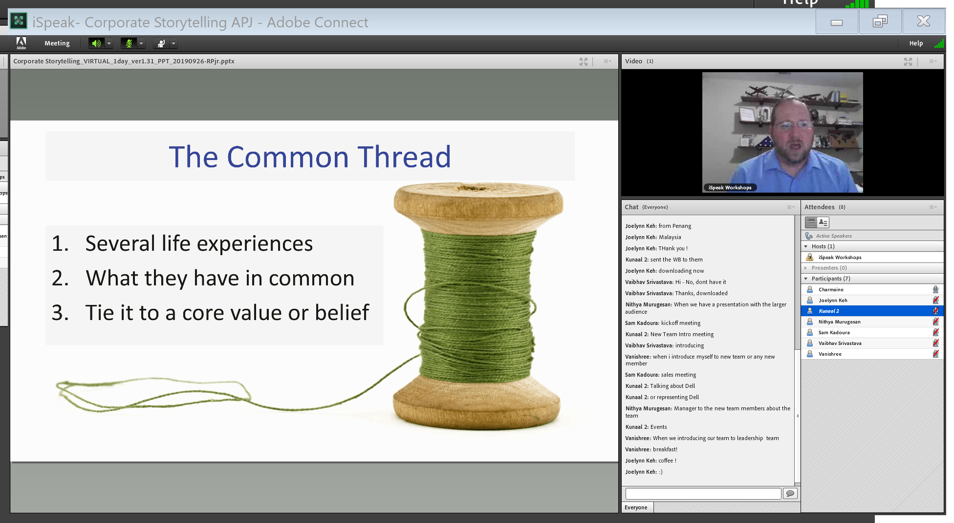

Slide 9
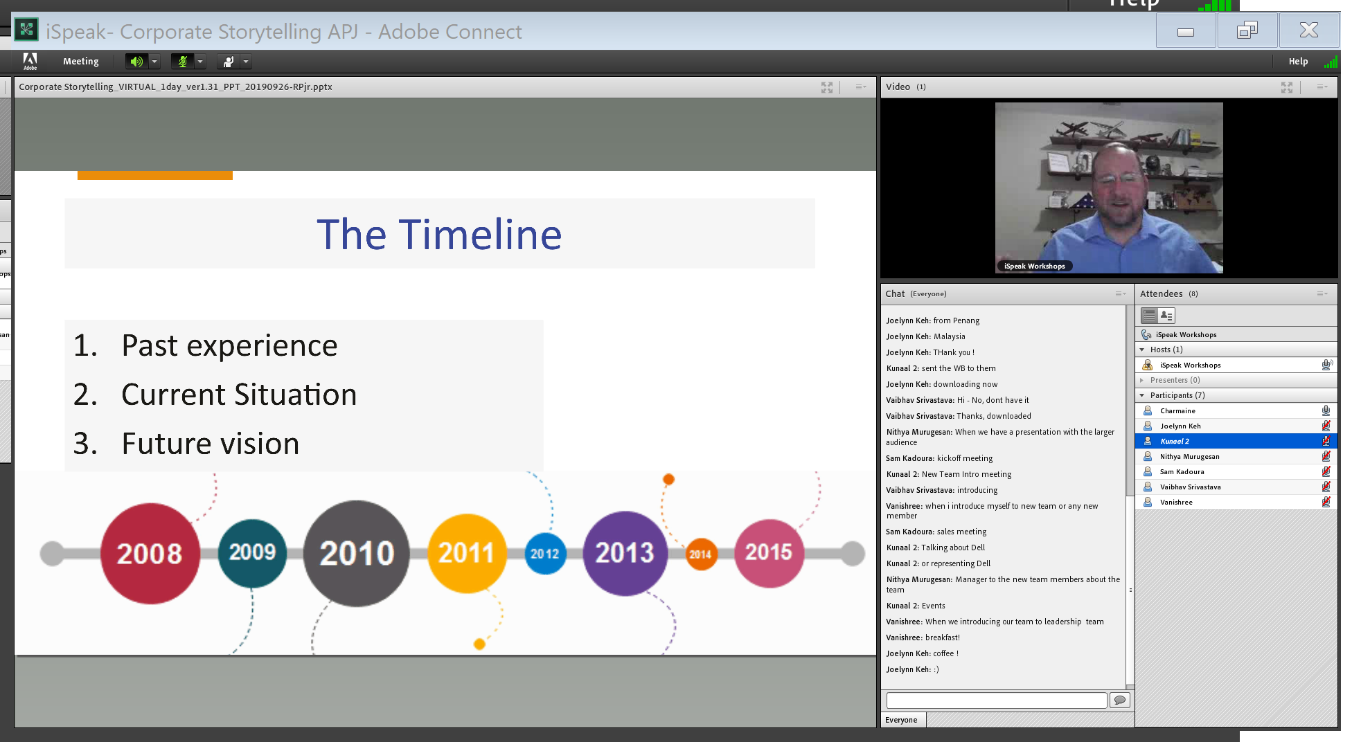

Slide 10
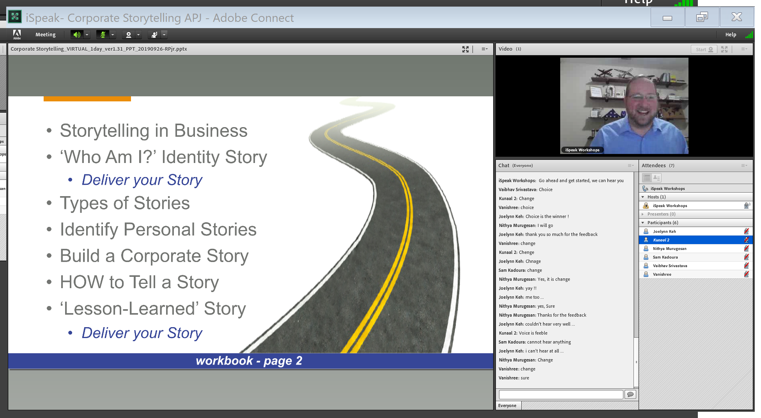

Slide 11
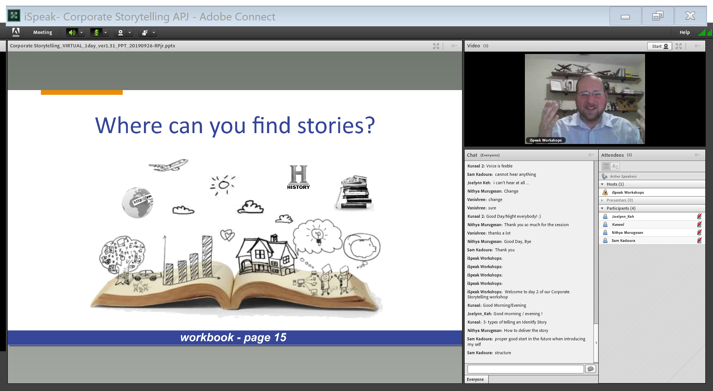

Slide 12
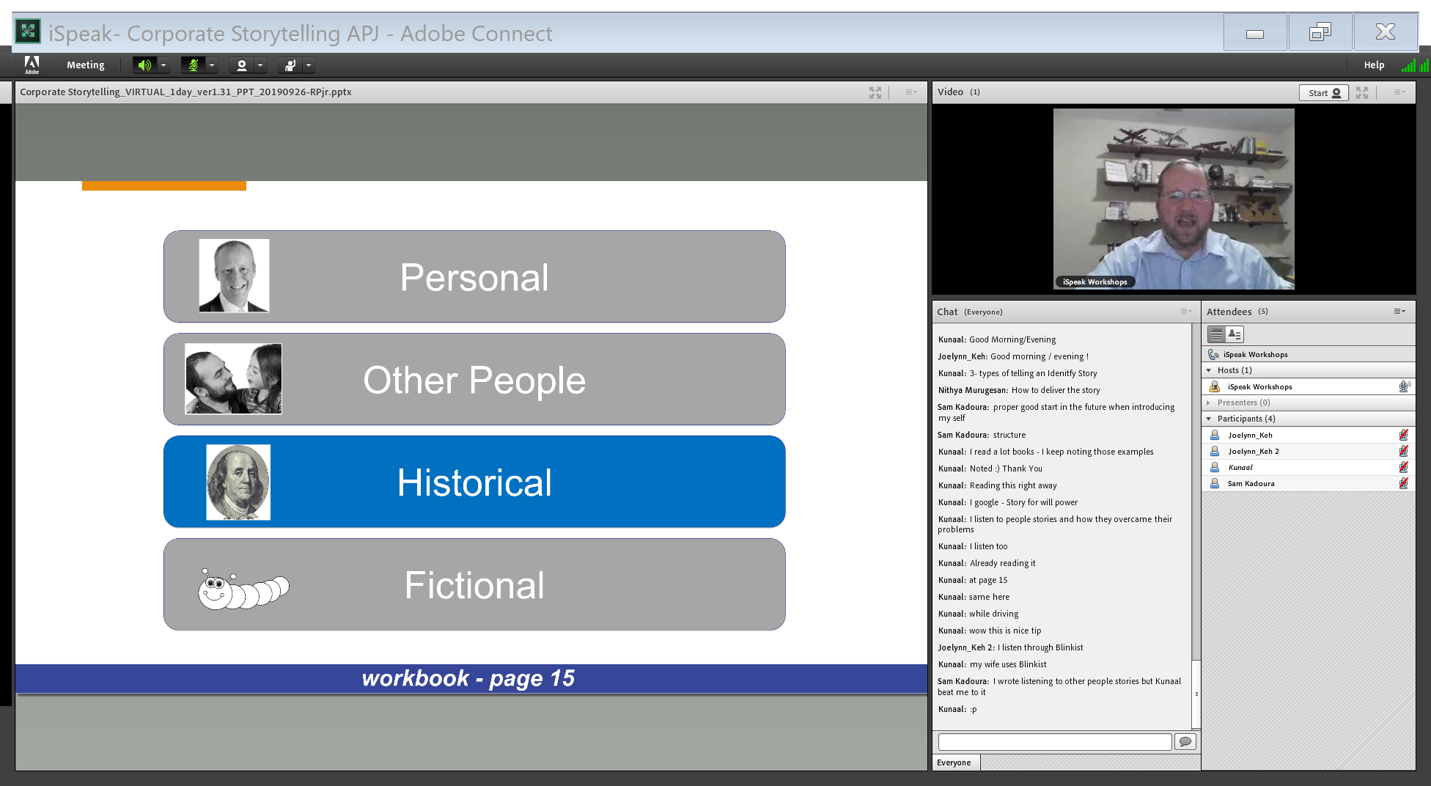

Slide 13
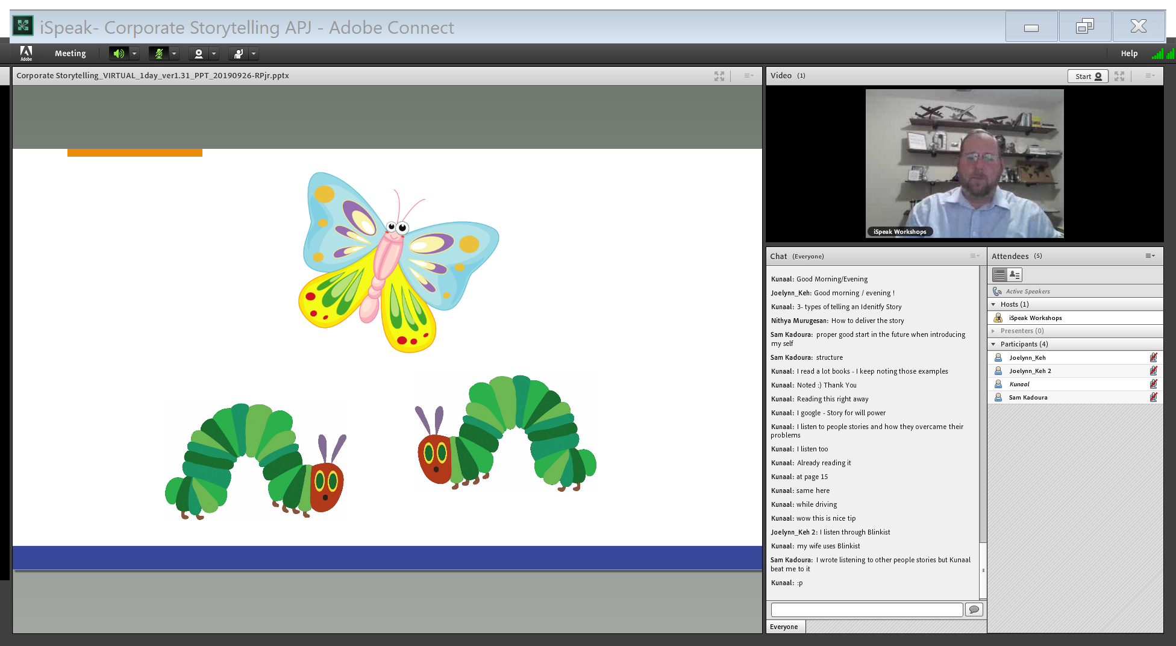
Fictional

Slide 14
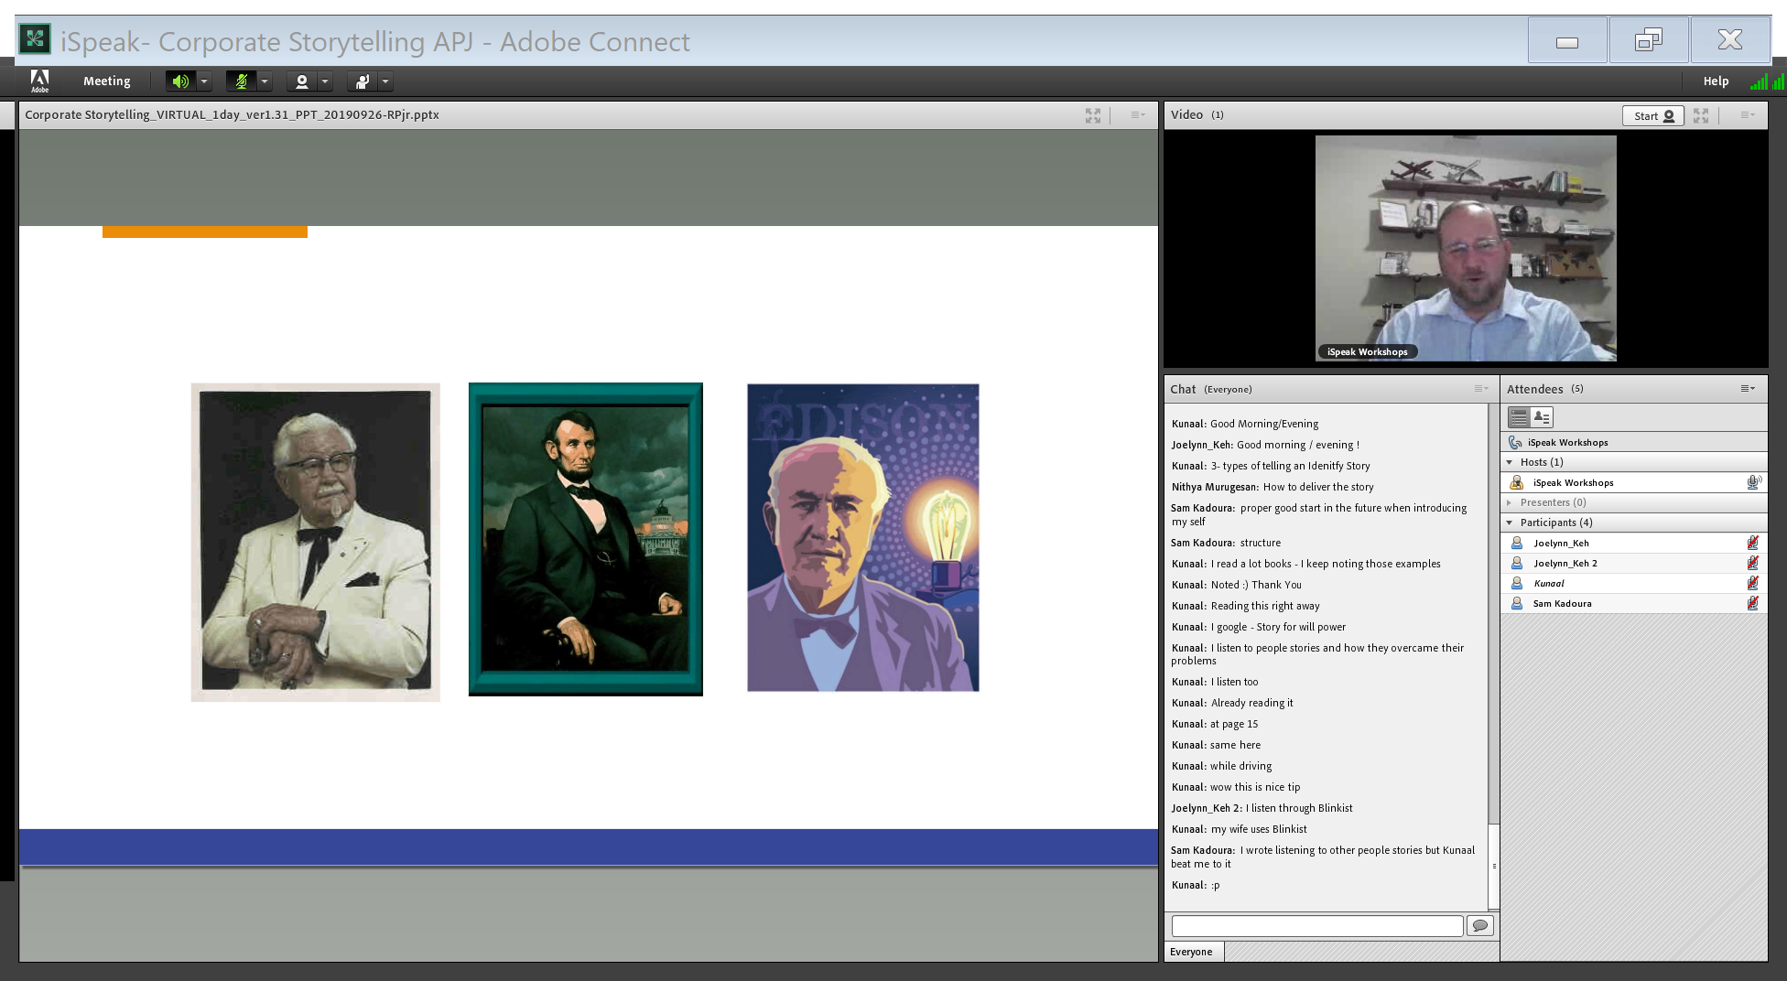
Historical

Slide 15
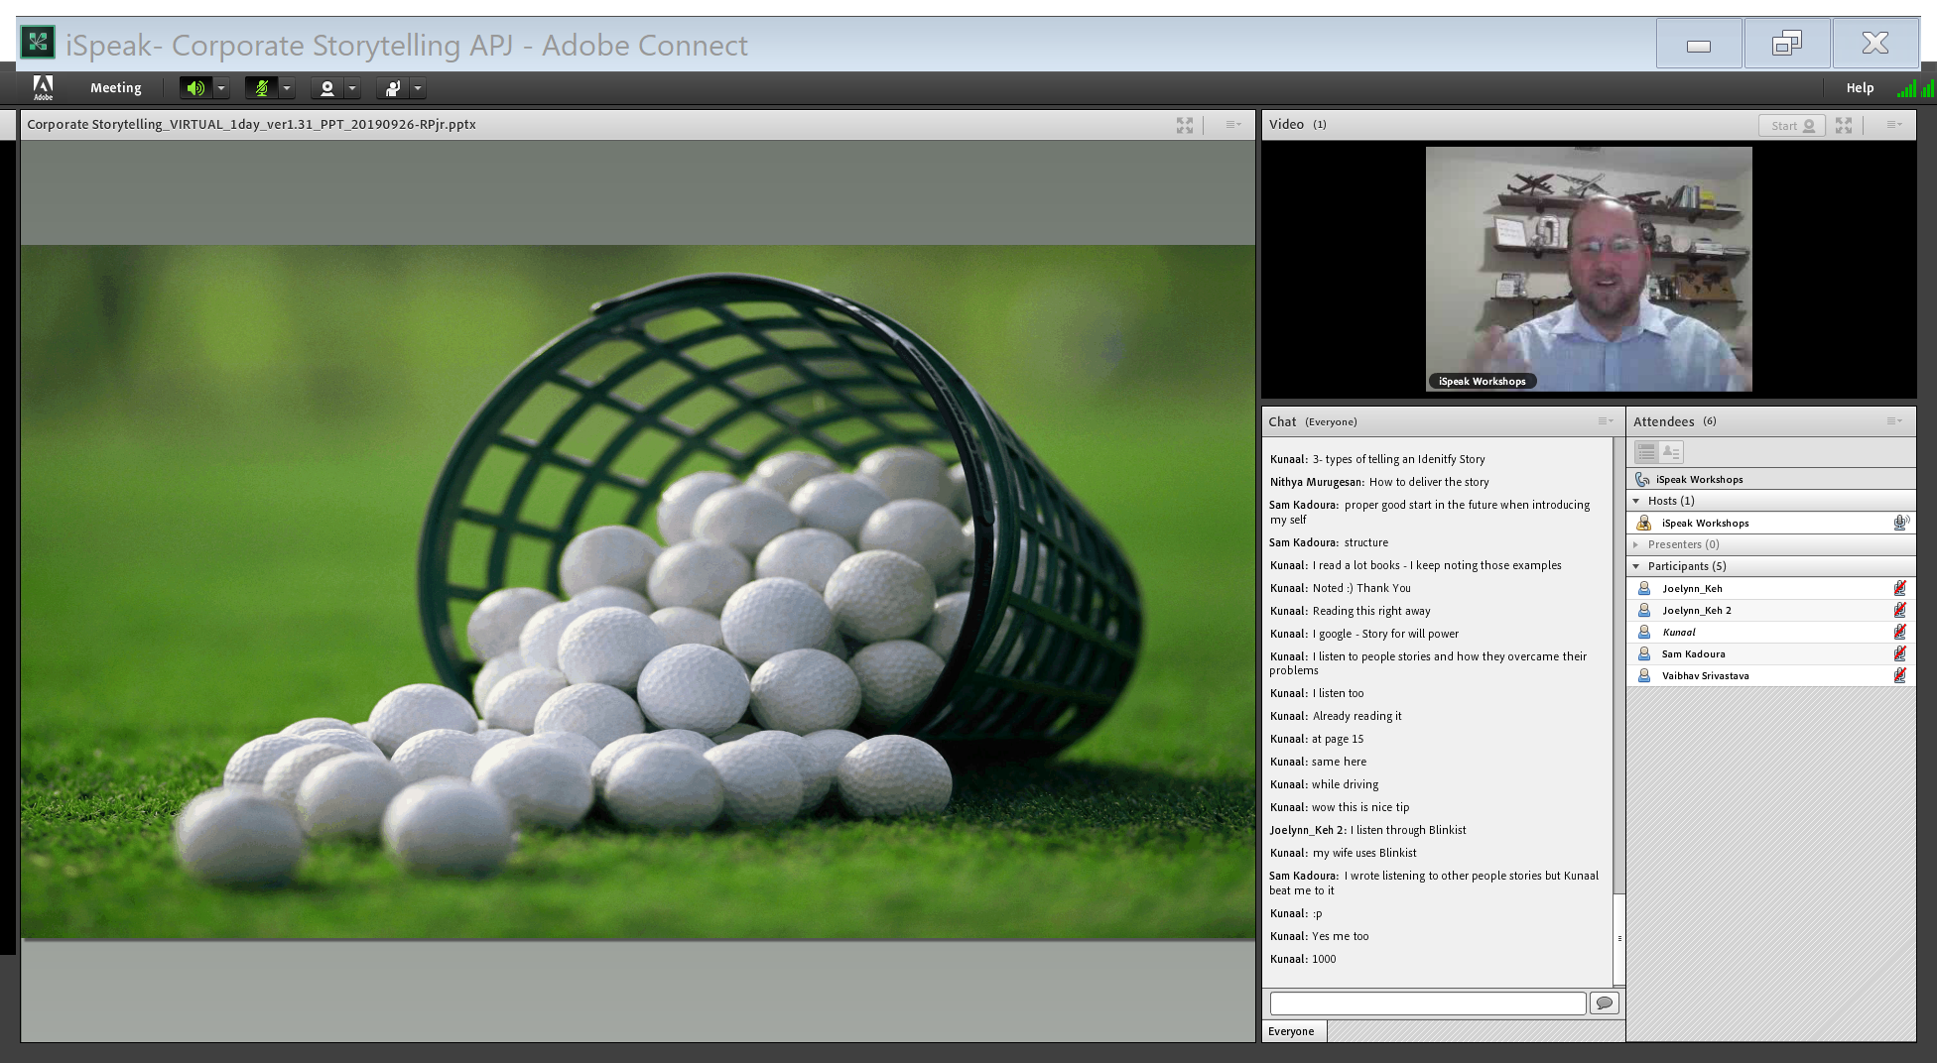
Stories from other people

Slide 16
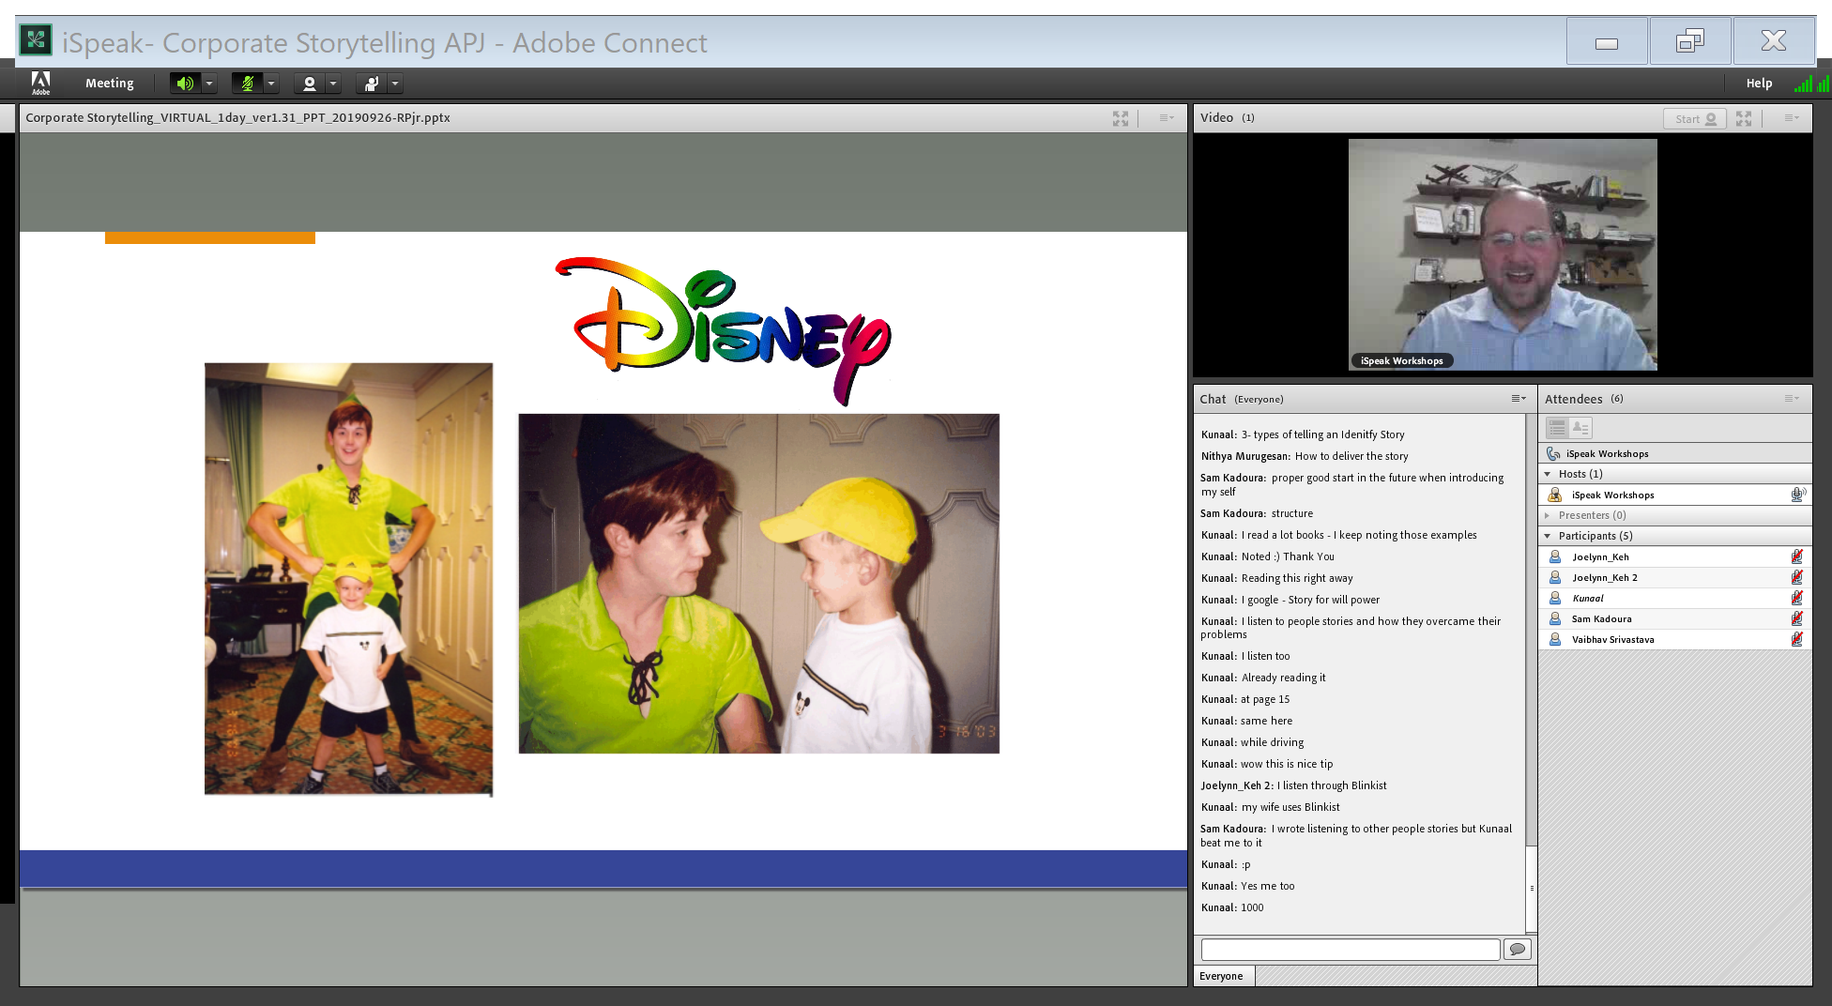

Slide 17
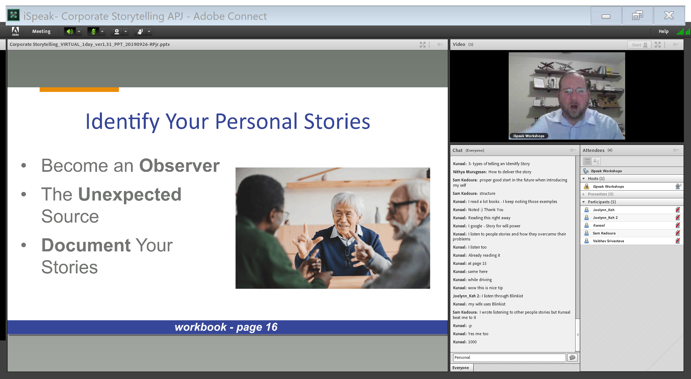

Slide 18
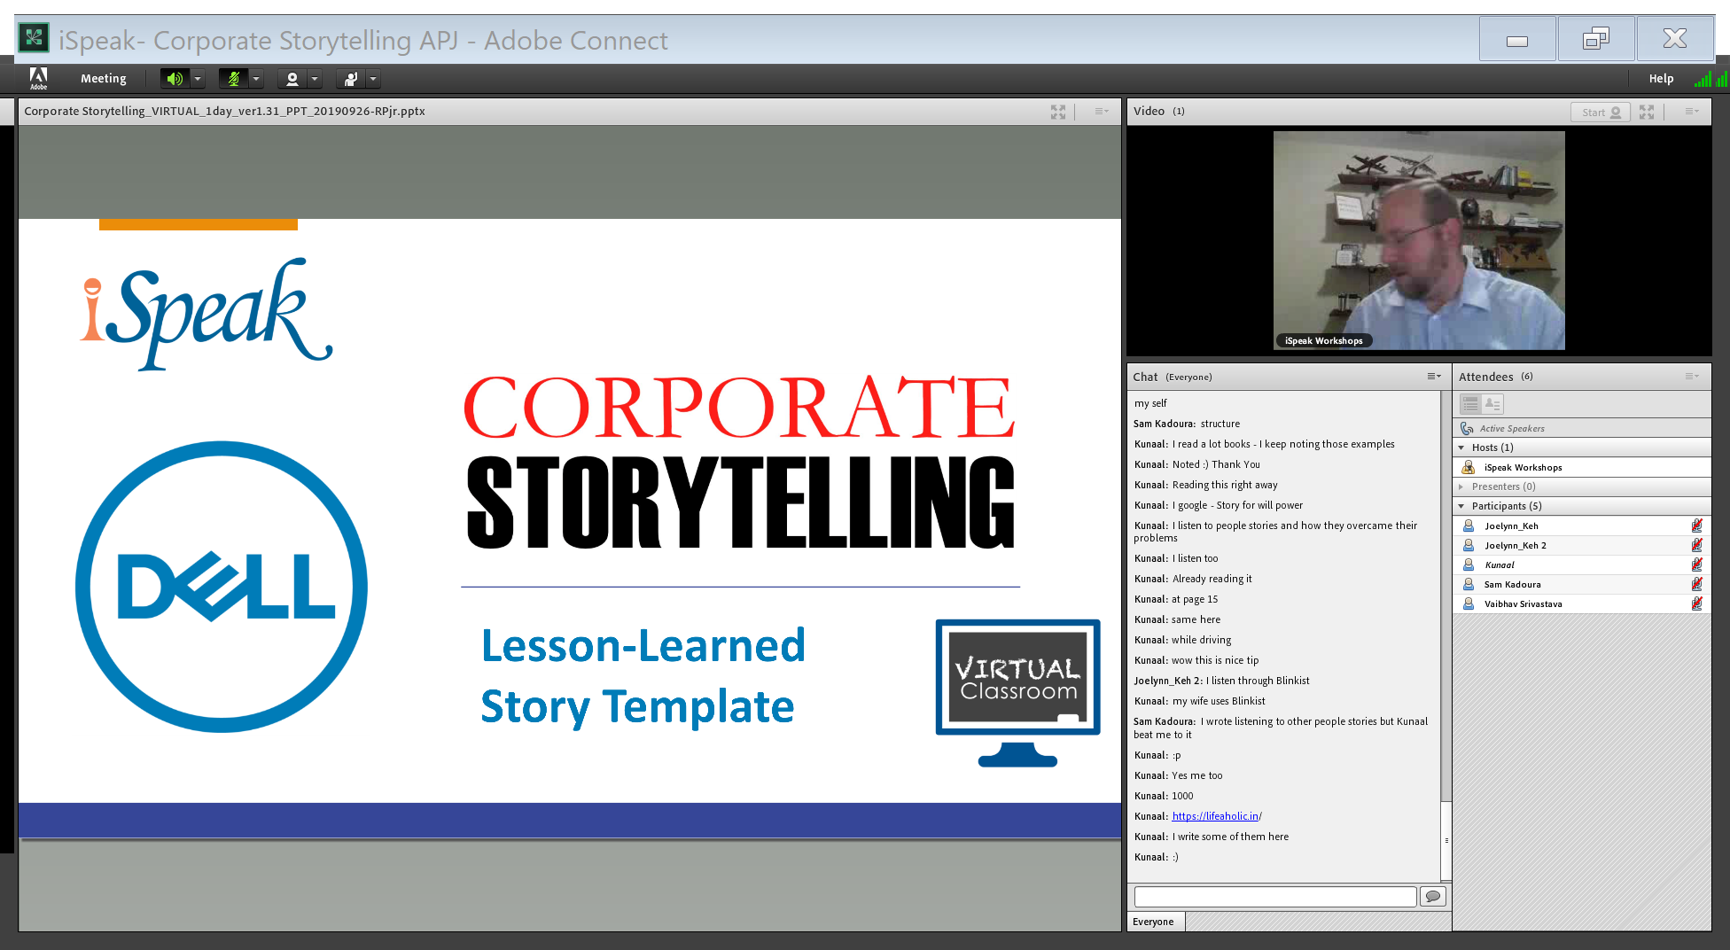

Slide 19
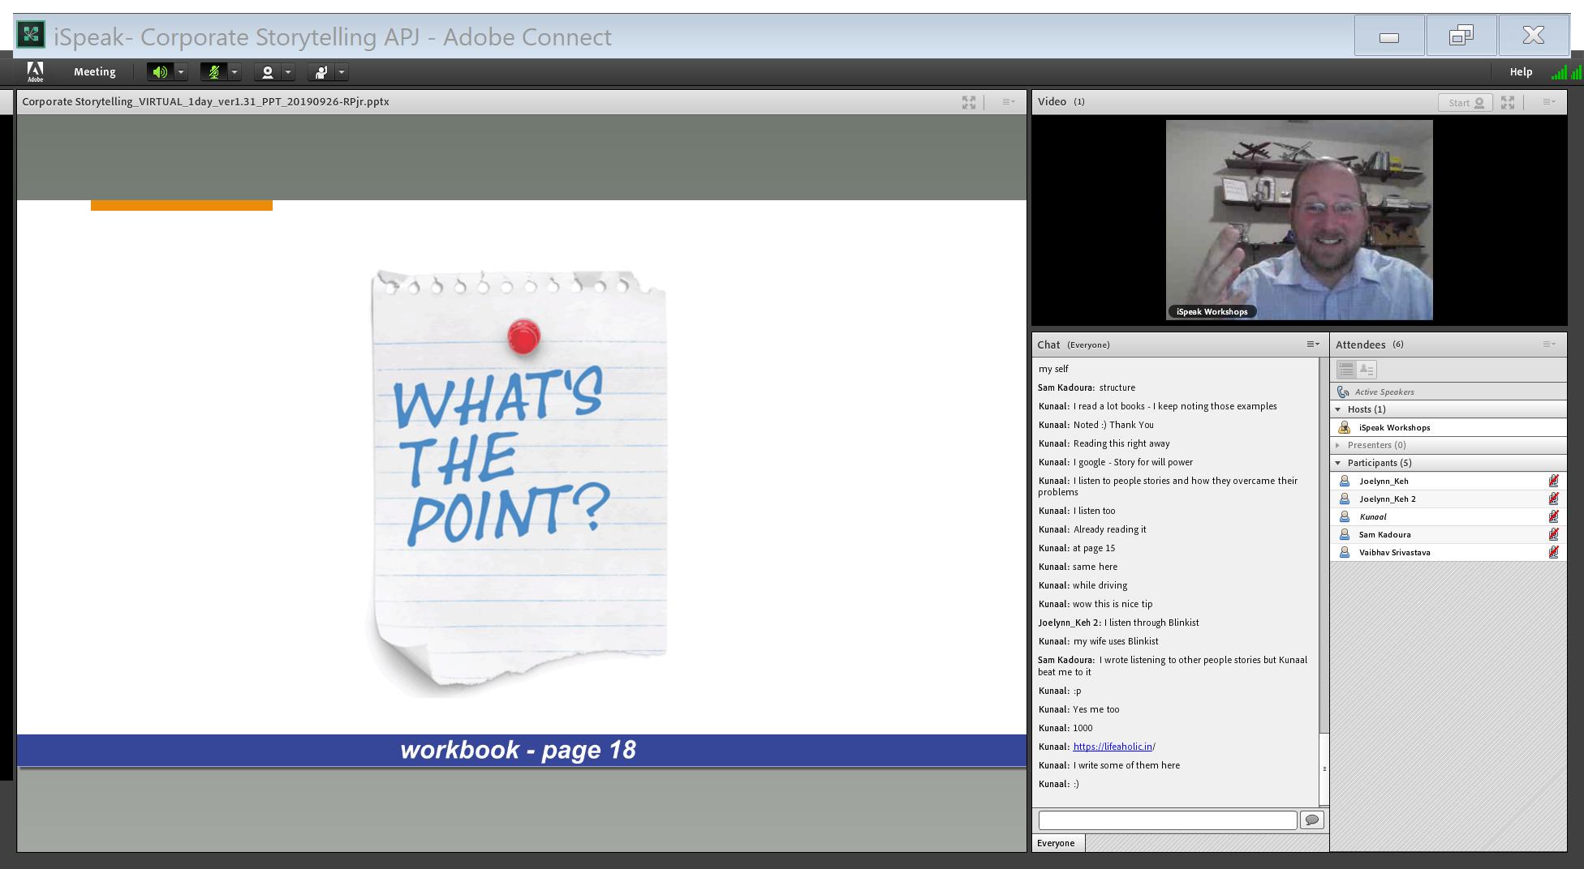
Why tell this story?

Slide 20
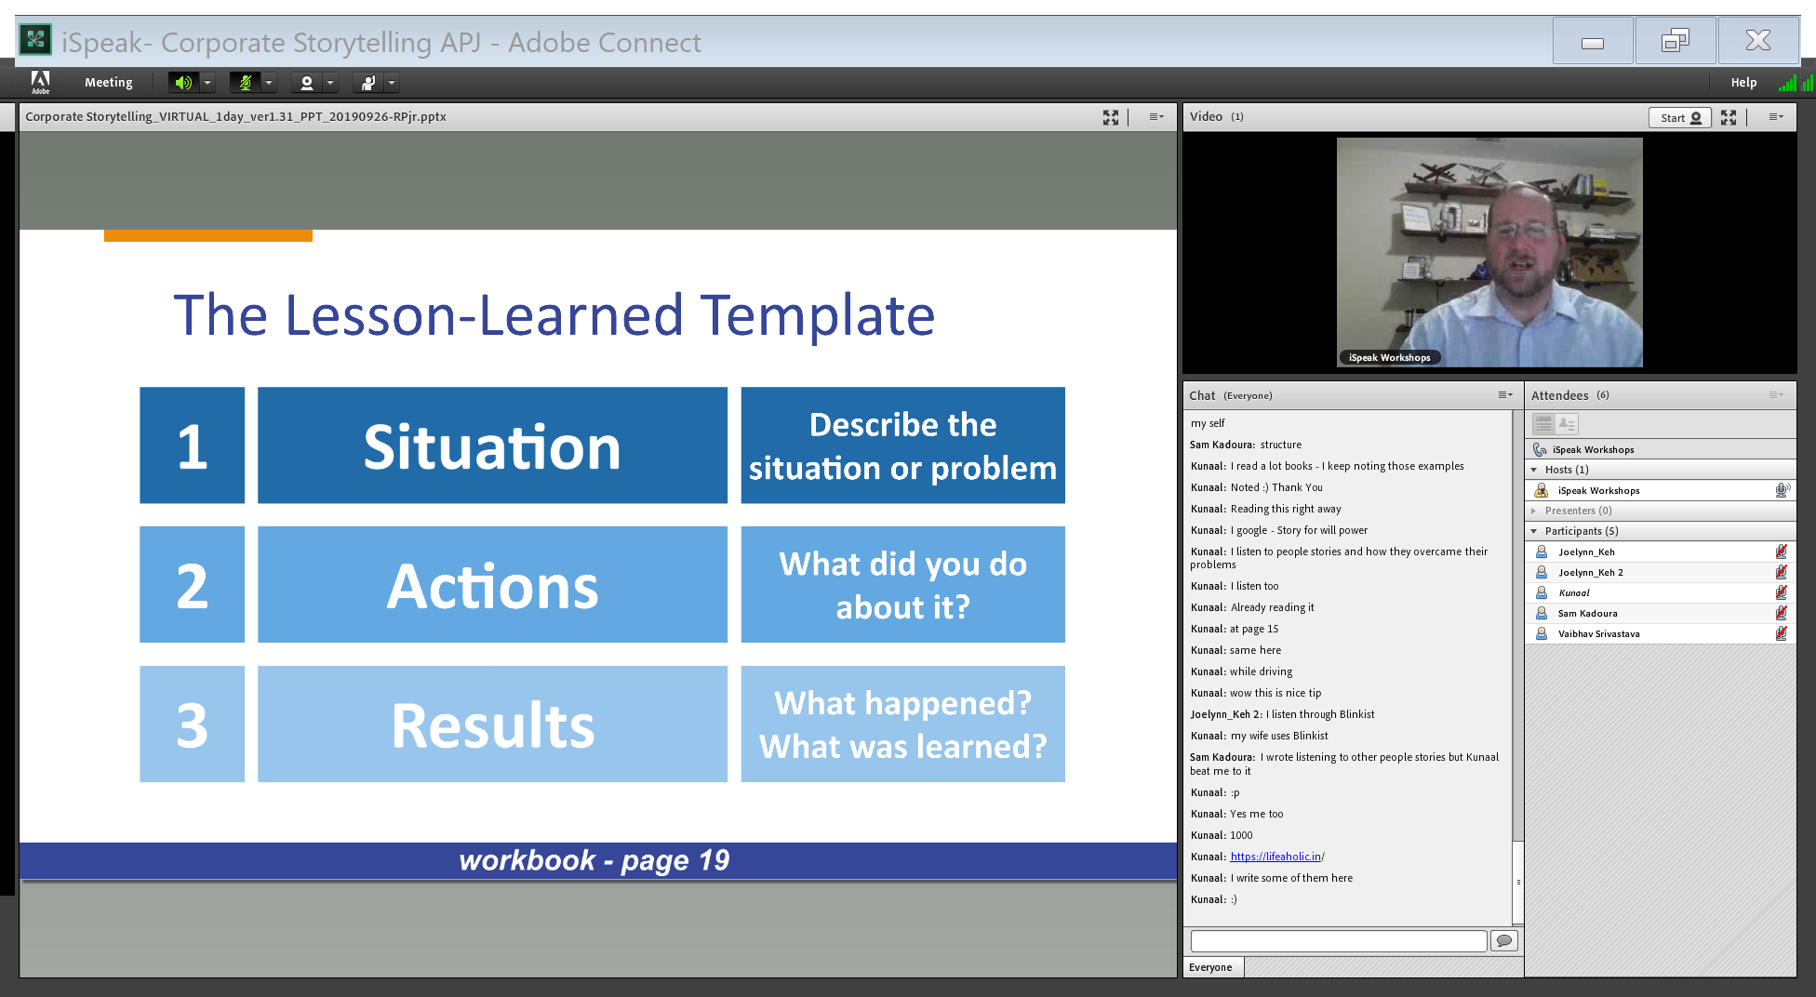

Slide 21
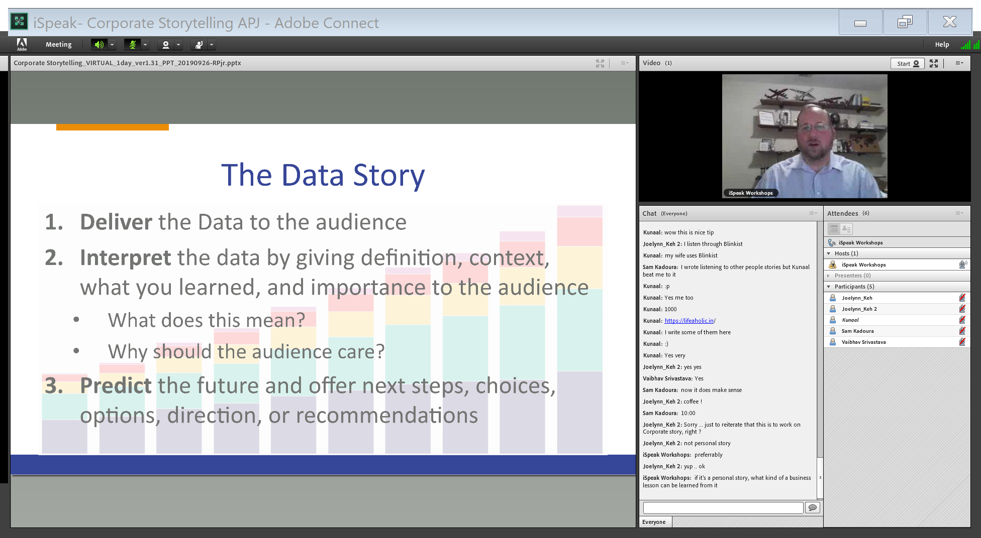

Slide 22
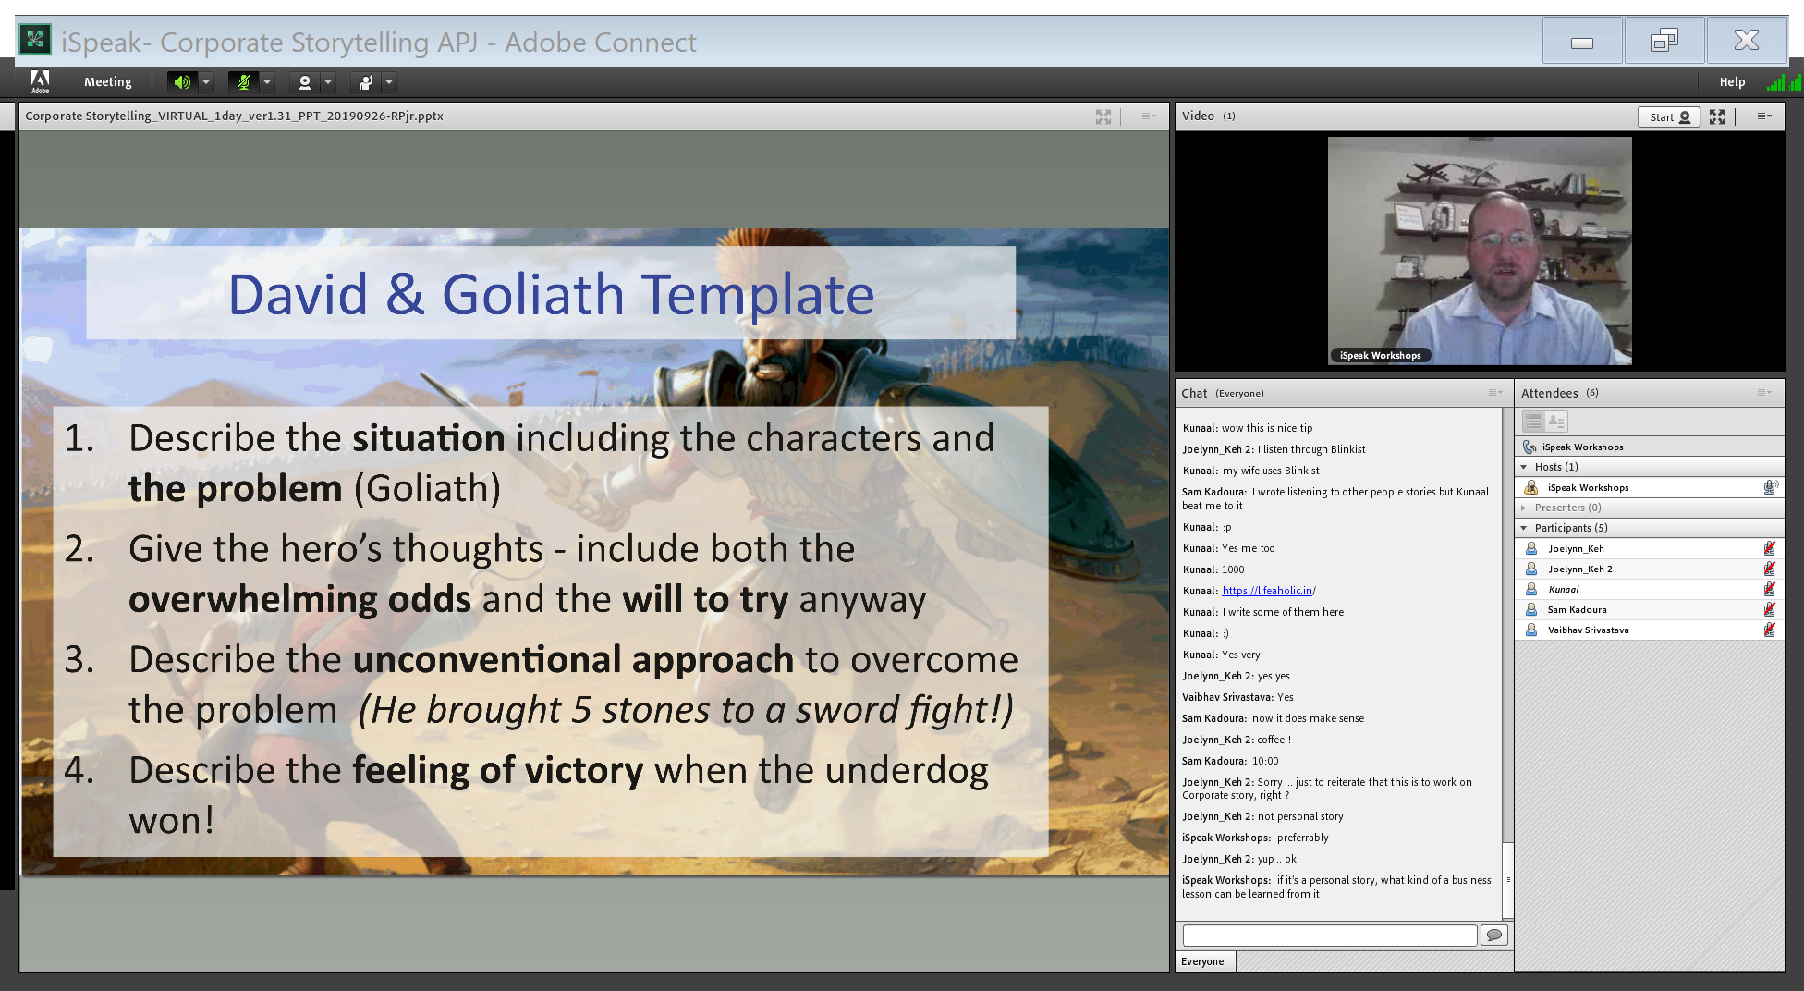

Slide 23
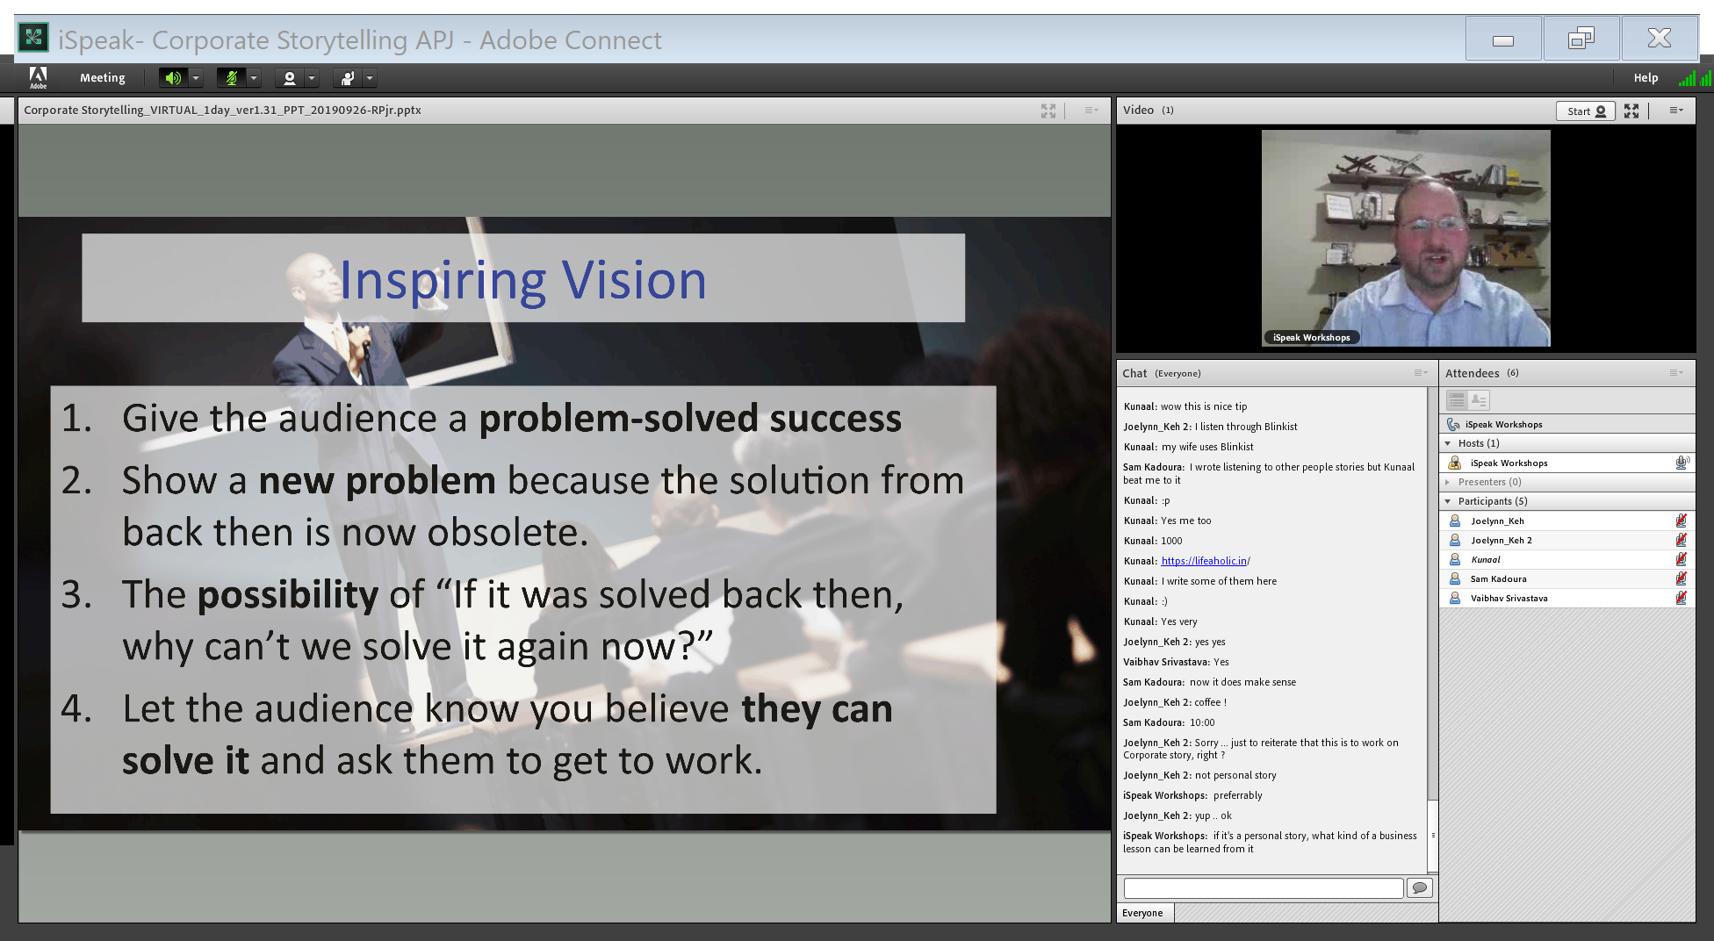

Slide 24
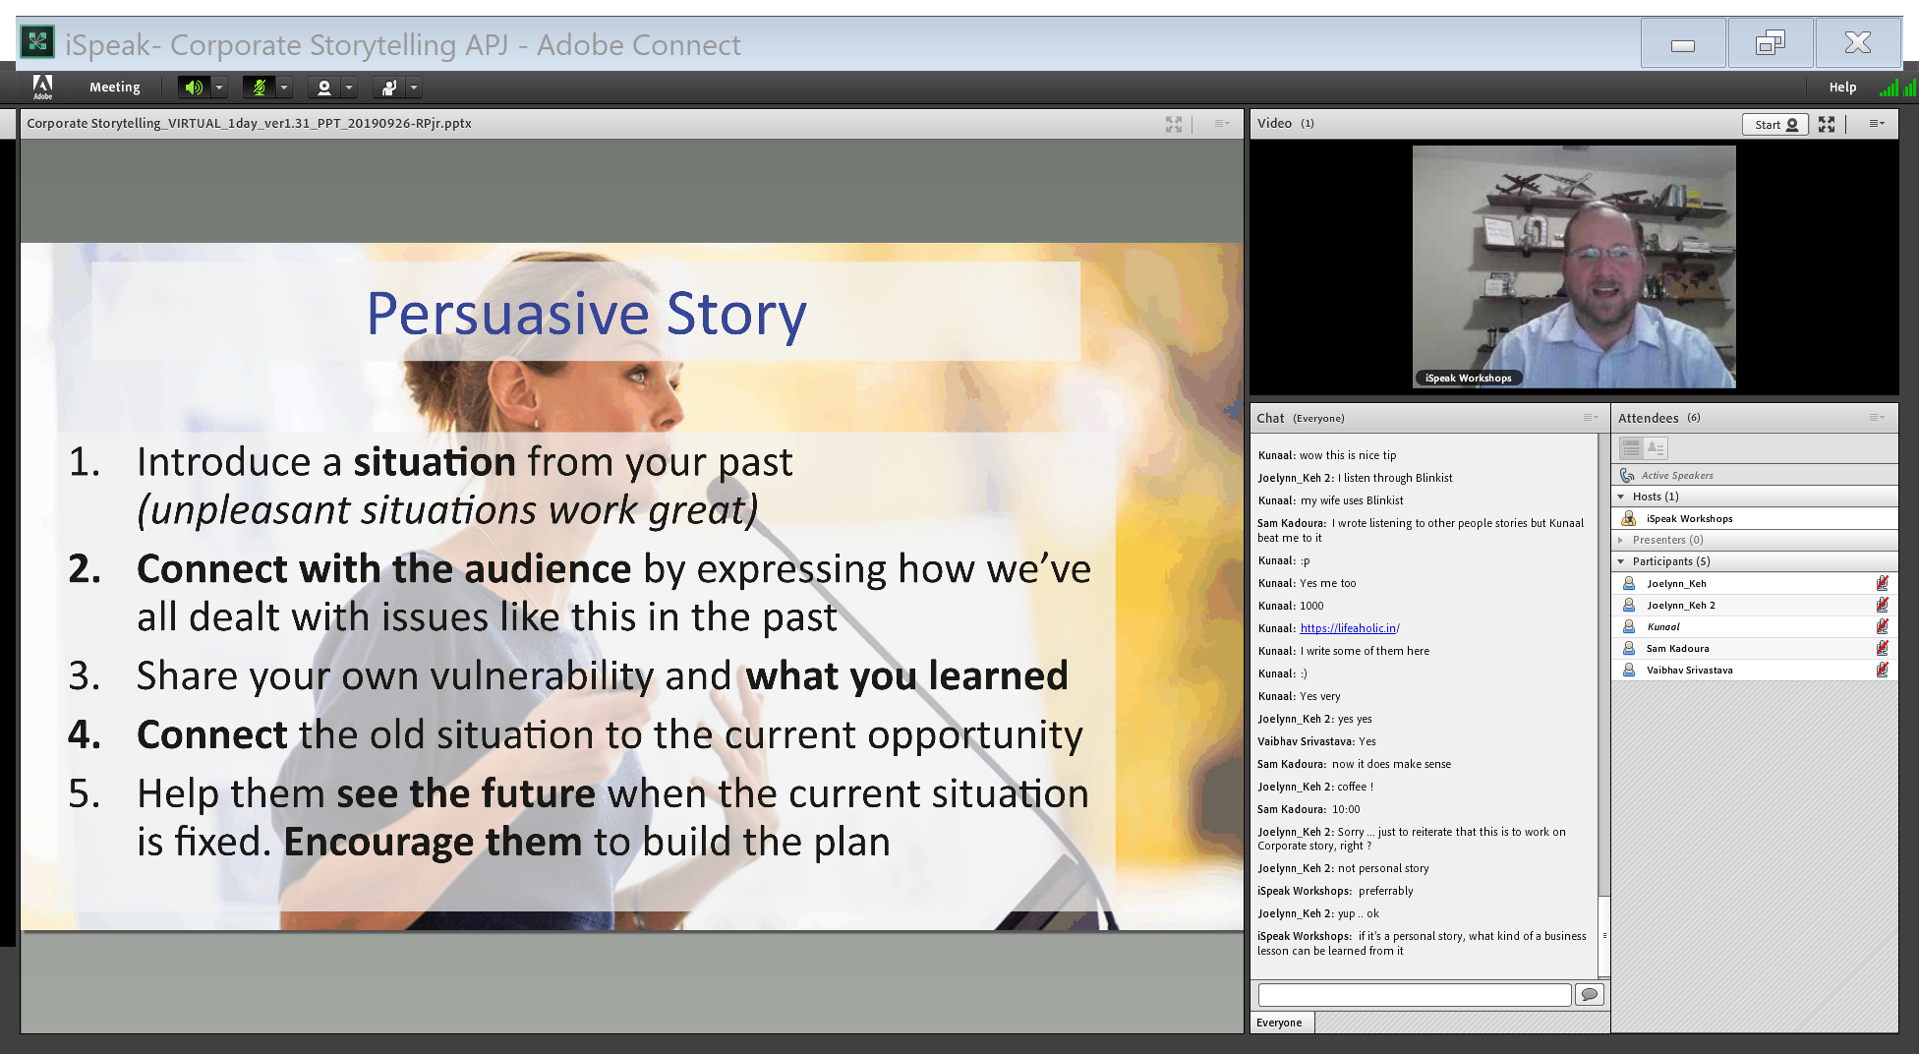

Slide 25
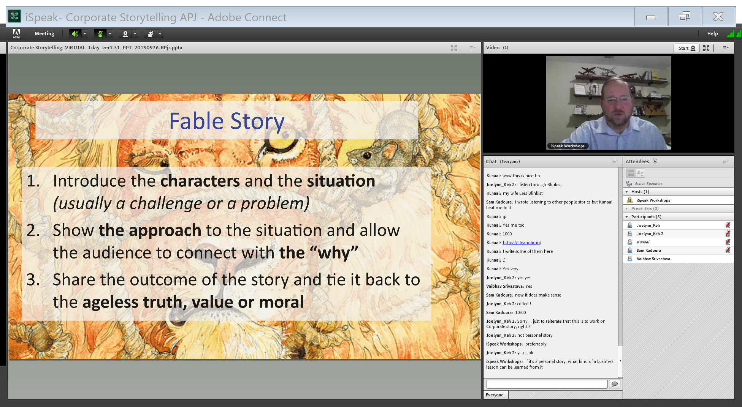

Slide 26
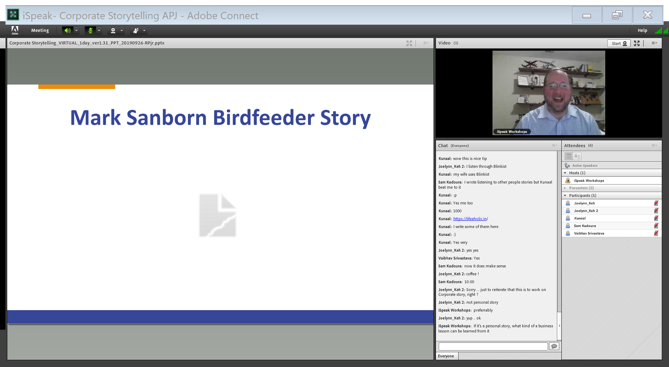
Focus beats Tech,

Slide 27
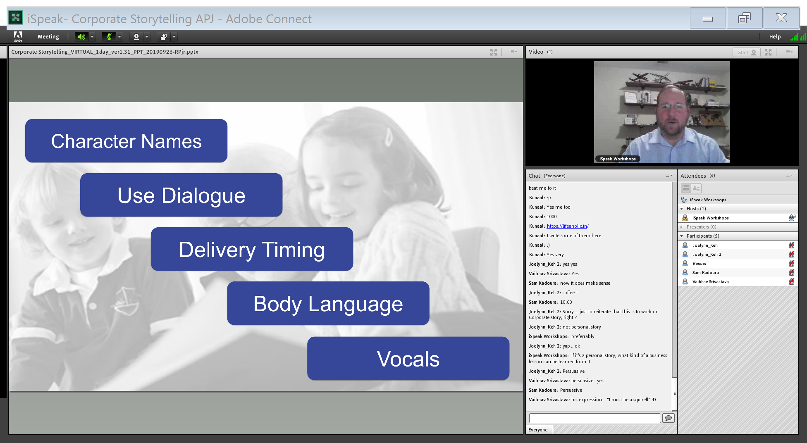

Slide 28
YouTube Channel
Opening : Have you ever been in a situation where your personal goals get pushed away? Like wanting to read or write?
Sustaining a Channel is hard – I have these bursts but then I cannot make time for videos
So I saw some Youtube Videos – as there is this community who has faced all these challenges and solved them
I sat down and broke my process – instead of doing it all in one session
Create Content – Record – Post
Closing : Now I have grown from having 800 to 1900 subscribers

